Slide 1
Intervention Trigger I(t) = 0.0182

Slide 2
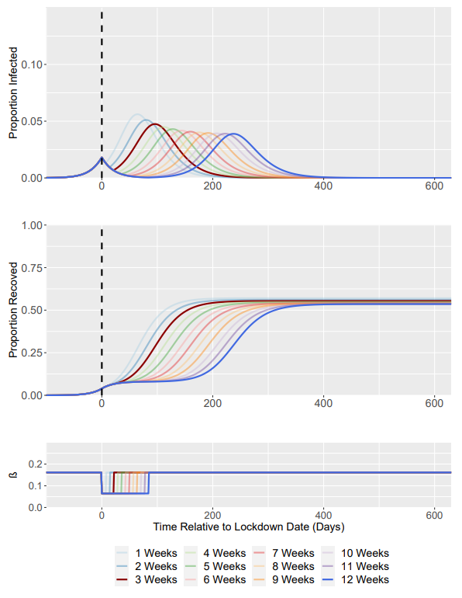
Baseline Scenario: Intervention Analysis Weeks 1-12
R₀ = 1.5 -> R₀ = 0.6
Weeks correspond to length of intervention
Highlighted (less transparent) lines correspond to Week 3 and Week 12
Dashed Line Represents Time of Intervention Start

Slide 3
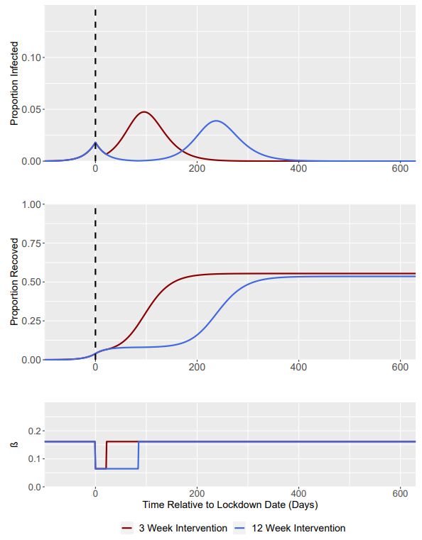
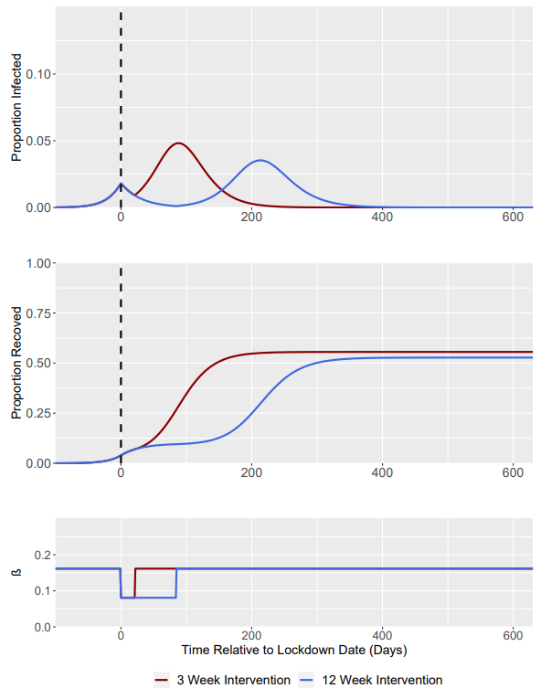
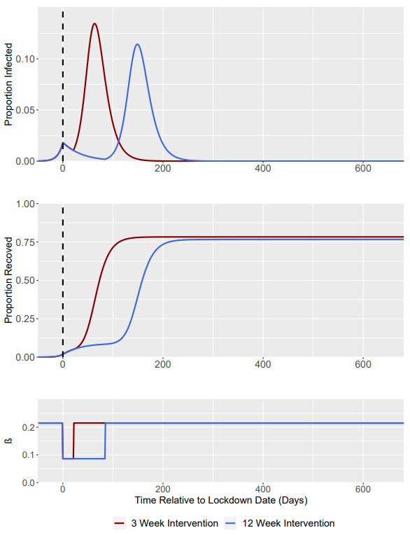
R₀ = 1.5 -> R₀ = 0.6 (Baseline)
R₀ = 1.5 -> R₀ = 0.75
R₀ = 2.0 -> R₀ = 0.8
Dashed Line Represents Time of Intervention Start

Slide 4
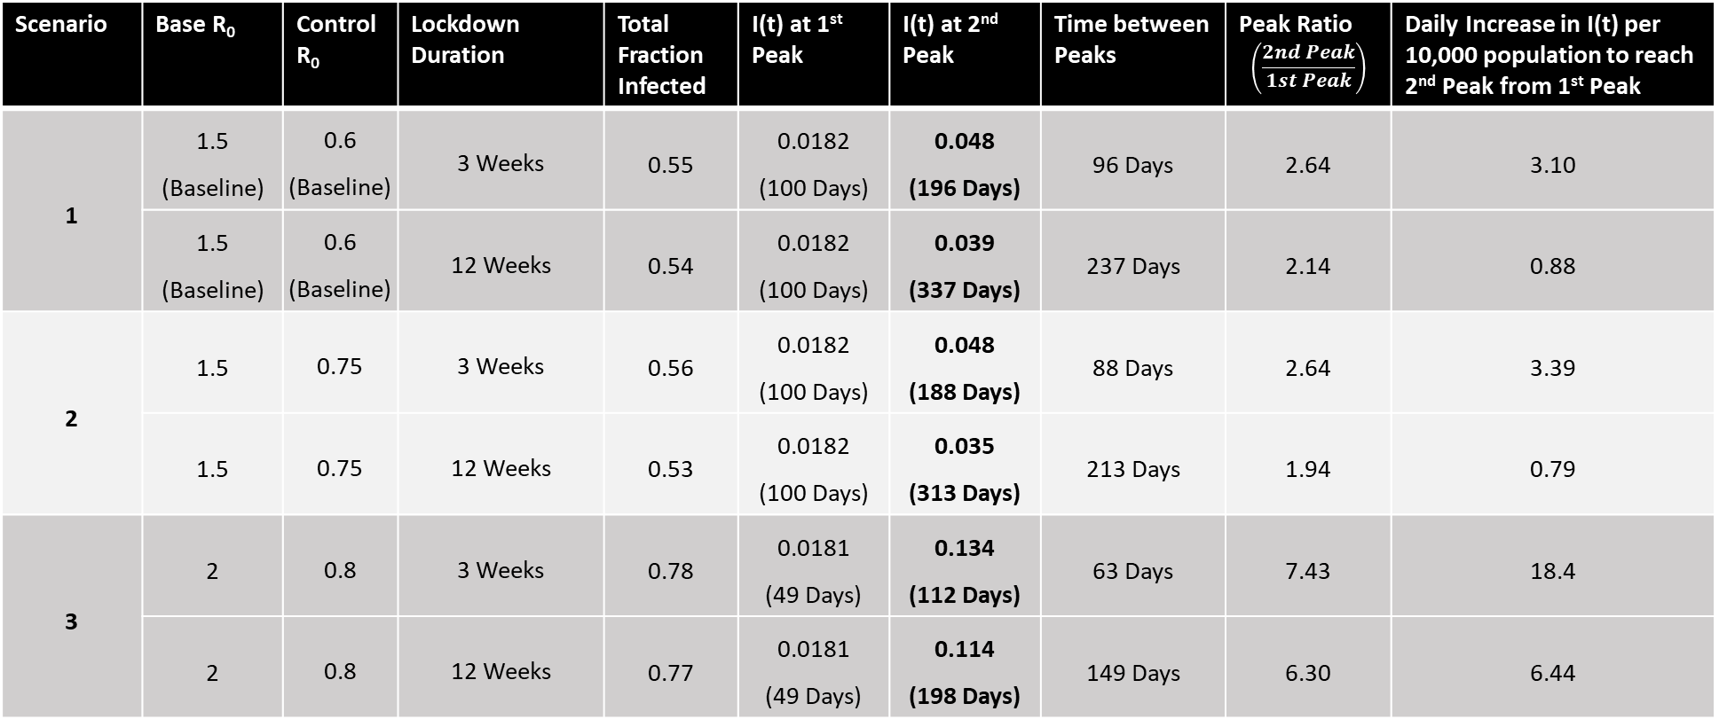
Intervention Trigger = when I(t) = 0.0182 (at t = 100 Days for Scenario 1 + 2; at t = 49 for Scenario 3)
Bold Denotes highest peak (in terms of I(t))
Scenario | Base R₀ | Control R₀ | Lockdown Duration | Total Fraction Infected | I(t) at 1st Peak | I(t) at 2nd Peak | Time between Peaks | Peak Ratio $$\left(\frac{2nd Peak}{1st Peak}\right)$$ | Daily Increase in I(t) per 10,000 population to reach 2nd Peak from 1st Peak
1 | 1.5 (Baseline) | 0.6 (Baseline) | 3 Weeks | 0.55 | 0.0182 (100 Days) | 0.048 (196 Days) | 96 Days | 2.64 | 3.10
 | 1.5 (Baseline) | 0.6 (Baseline) | 12 Weeks | 0.54 | 0.0182 (100 Days) | 0.039 (337 Days) | 237 Days | 2.14 | 0.88
2 | 1.5 | 0.75 | 3 Weeks | 0.56 | 0.0182 (100 Days) | 0.048 (188 Days) | 88 Days | 2.64 | 3.39
 | 1.5 | 0.75 | 12 Weeks | 0.53 | 0.0182 (100 Days) | 0.035 (313 Days) | 213 Days | 1.94 | 0.79
3 | 2 | 0.8 | 3 Weeks | 0.78 | 0.0181 (49 Days) | 0.134 (112 Days) | 63 Days | 7.43 | 18.4
 | 2 | 0.8 | 12 Weeks | 0.77 | 0.0181 (49 Days) | 0.114 (198 Days) | 149 Days | 6.30 | 6.44
Daily Increase in I(t) per 10,000 population defined as: $\left(\frac{2nd Peak I\left(t\right)−1st Peak I(t)}{Time Between Peaks}\right)∗10000$

Slide 5
Intervention Trigger I(t) = 0.0054

Slide 6
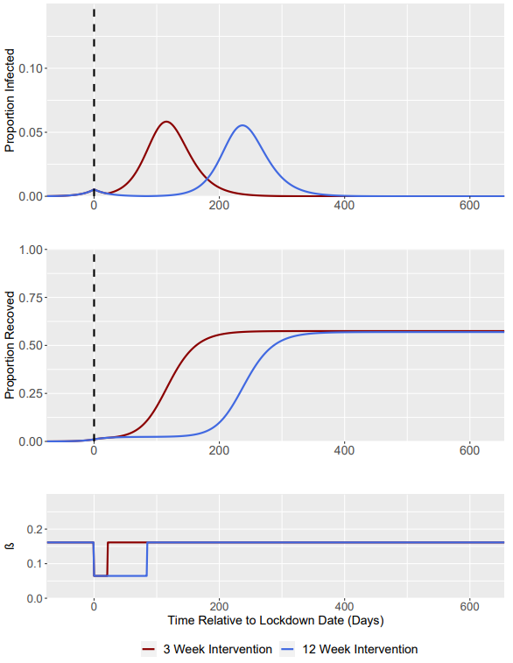
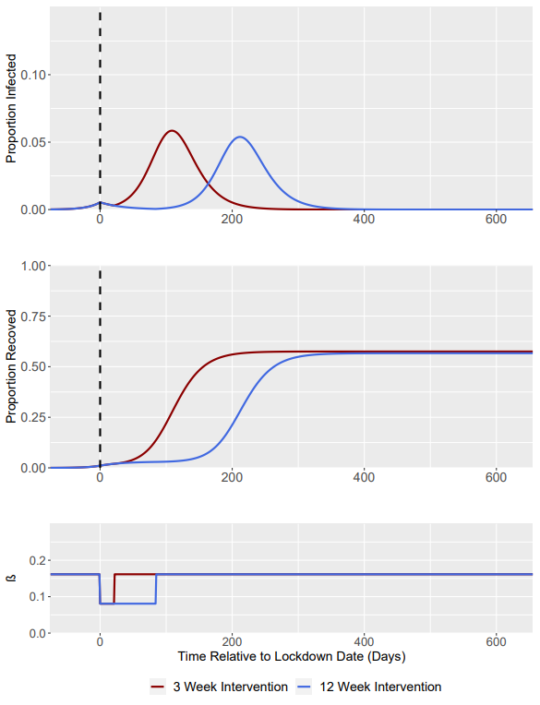
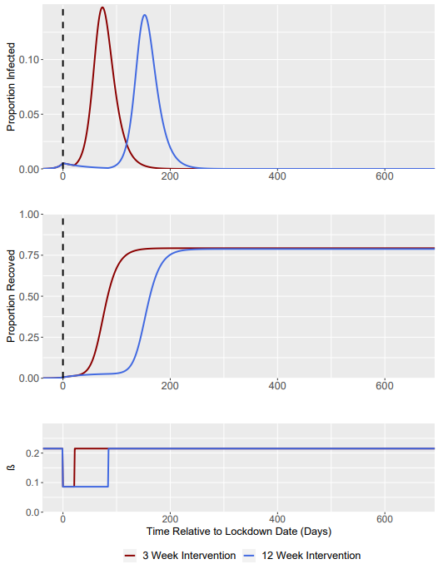
R₀ = 1.5 -> R₀ = 0.6 (Baseline)
R₀ = 1.5 -> R₀ = 0.75
R₀ = 2.0 -> R₀ = 0.8
Dashed Line Represents Time of Intervention Start

Slide 7

Intervention Trigger = when I(t) = 0.0054 (at t = 75 Days for scenario 1 + 2; at t = 37 Days for scenario 3)
Bold Denotes highest peak (in terms of I(t))
Scenario | Base R₀ | Control R₀ | Lockdown Duration | Total Fraction Infected | I(t) at 1st Peak | I(t) at 2nd Peak | Time between Peaks | Peak Ratio $$\left(\frac{2nd Peak}{1st Peak}\right)$$ | Daily Increase in I(t) per 10,000 population to reach 2nd Peak from 1st Peak
1 | 1.5 (Baseline) | 0.6 (Baseline) | 3 Weeks | 0.58 | 0.0054 (75 Days) | 0.058 (190 Days) | 115 Days | 10.8 | 4.57
 | 1.5 (Baseline) | 0.6 (Baseline) | 12 Weeks | 0.57 | 0.0054 (75 Days) | 0.055 (312 Days) | 237 Days | 10.3 | 2.09
2 | 1.5 | 0.75 | 3 Weeks | 0.58 | 0.0054 (75 Days) | 0.059 (184 Days) | 109 Days | 10.8 | 4.92
 | 1.5 | 0.75 | 12 Weeks | 0.57 | 0.0054 (75 Days) | 0.054 (Day 287) | 212 Days | 9.98 | 2.29
3 | 2 | 0.8 | 3 Weeks | 0.79 | 0.0053 (37 Days) | 0.148 (111 Days) | 74 Days | 27.9 | 19.2
 | 2 | 0.8 | 12 Weeks | 0.79 | 0.0053 (37 Days) | 0.141 (189 Days) | 152 Days | 26.6 | 8.93
Daily Increase in I(t) per 10,000 population defined as: $\left(\frac{2nd Peak I\left(t\right)−1st Peak I(t)}{Time Between Peaks}\right)∗10000$

Slide 8
Intervention Trigger I(t) = 0.0455

Slide 9
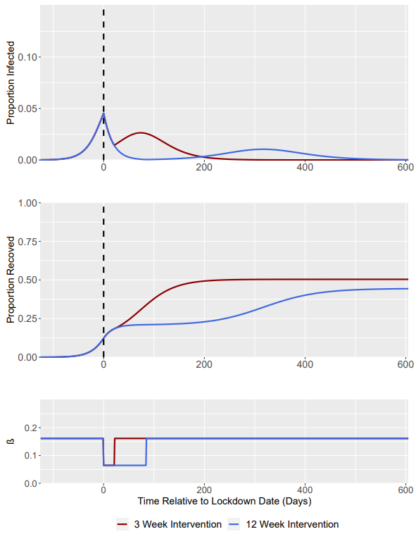
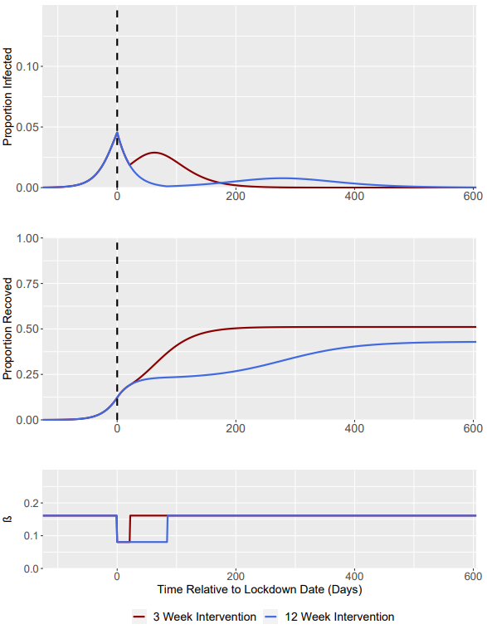
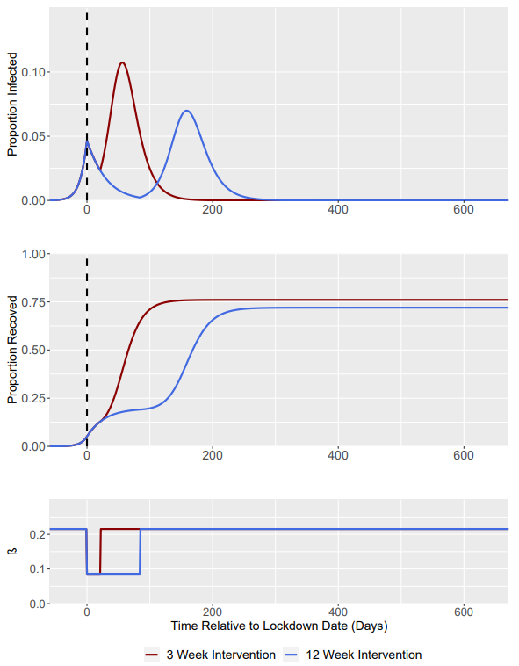
R₀ = 1.5 -> R₀ = 0.6 (Baseline)
R₀ = 1.5 -> R₀ = 0.75
R₀ = 2.0 -> R₀ = 0.8
Dashed Line Represents Time of Intervention Start

Slide 10
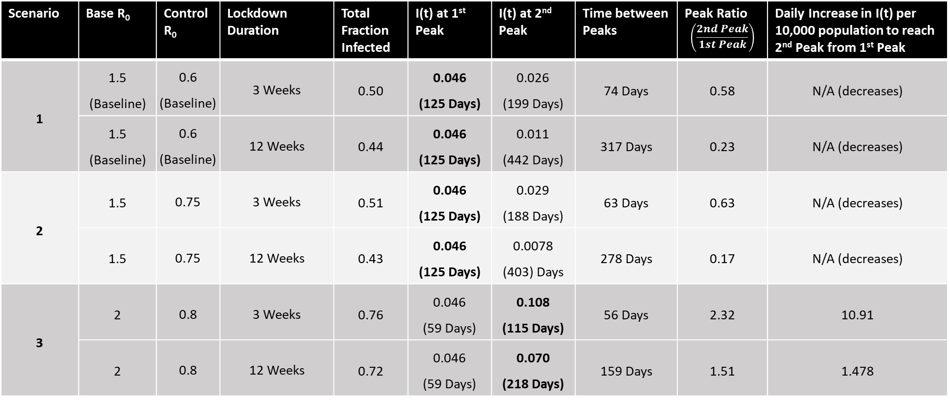
Intervention Trigger = when I(t) = 0.0455 (at t = 125 Days for scenario 1 + 2, at t = 59 Days for scenario 3)
Bold Denotes highest peak (in terms of I(t))
Scenario | Base R₀ | Control R₀ | Lockdown Duration | Total Fraction Infected | I(t) at 1st Peak | I(t) at 2nd Peak | Time between Peaks | Peak Ratio $$\left(\frac{2nd Peak}{1st Peak}\right)$$ | Daily Increase in I(t) per 10,000 population to reach 2nd Peak from 1st Peak
1 | 1.5 (Baseline) | 0.6 (Baseline) | 3 Weeks | 0.50 | 0.046 (125 Days) | 0.026 (199 Days) | 74 Days | 0.58 | N/A (decreases)
 | 1.5 (Baseline) | 0.6 (Baseline) | 12 Weeks | 0.44 | 0.046 (125 Days) | 0.011 (442 Days) | 317 Days | 0.23 | N/A (decreases)
2 | 1.5 | 0.75 | 3 Weeks | 0.51 | 0.046 (125 Days) | 0.029 (188 Days) | 63 Days | 0.63 | N/A (decreases)
 | 1.5 | 0.75 | 12 Weeks | 0.43 | 0.046 (125 Days) | 0.0078 (403) Days | 278 Days | 0.17 | N/A (decreases)
3 | 2 | 0.8 | 3 Weeks | 0.76 | 0.046 (59 Days) | 0.108 (115 Days) | 56 Days | 2.32 | 10.91
 | 2 | 0.8 | 12 Weeks | 0.72 | 0.046 (59 Days) | 0.070 (218 Days) | 159 Days | 1.51 | 1.478
Daily Increase in I(t) per 10,000 population defined as: $\left(\frac{2nd Peak I\left(t\right)−1st Peak I(t)}{Time Between Peaks}\right)∗10000$

